Slide 1
Lecture 3
Math Foundations Team

Slide 2
Analytic geometry
We have studied vector spaces in the previous lecture.
Now we would like to provide some geometric interpretation to these concepts.
We shall take a close look at geometric vectors and the concepts of lengths of vectors and angles between vectors.
But first we need to add the concept of an inner product to our vector space.

Slide 3
Motivation to study the distance between vectors
First let us introduce Similarity and Dissimilarity between data Objects:
Similarity is a numerical measure of how alike two data objects are
Value is higher when data objects are more alike
Often falls in the range of [0,1] (Otherwise one can normalize)
Dissimilarity is a numerical measure of how different two data objects are
Lower when objects are more alike
Minimum dissimilarity is 0
Upper limits varies

Slide 4
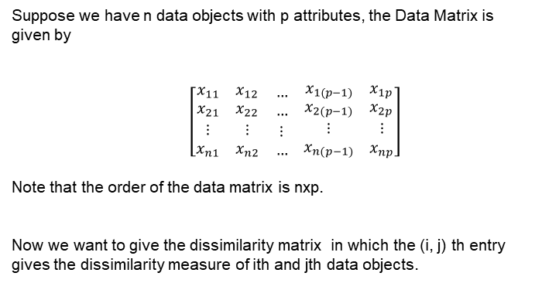
The Data Matrix and Dissimilarity matrix
Data Objects
x₁
x₂
x_{n}
Attributes

Slide 5
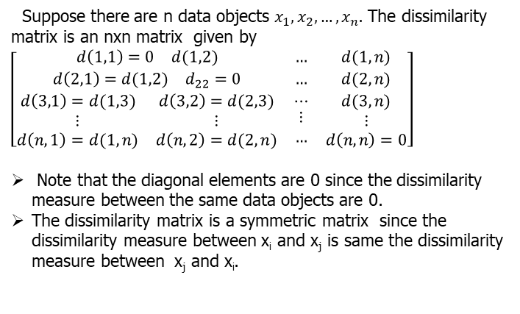
Dissimilarity Matrix

Slide 6
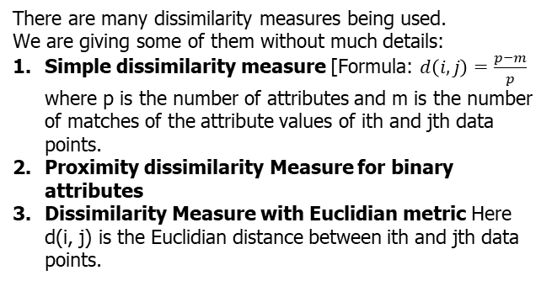
Dissimilarity Measures

Slide 7
Example of a dissimilarity matrix with Euclidian distance
Suppose our data matrix of four data objects is given by
Data Object | Attribute 1 | Attribute 2
x₁ | 1 | 2
x₂ | 3 | 5
x₃ | 2 | 0
x₄ | 4 | 5

Slide 8
Example of a dissimilarity matrix with Euclidian distance
 | x₁ | x₂ | x₃ | x₄
x₁ | 0 | 3.61 | 2.24 | 4.24
x₂ | 3.61 | 0 | 5.1 | 1
x₃ | 2.24 | 5.1 | 0 | 5.39
x₄ | 4.24 | 1 | 5.39 | 0

Slide 9
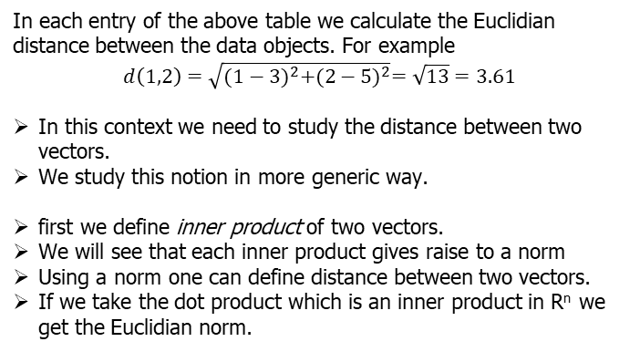
Example Ctd

Slide 10
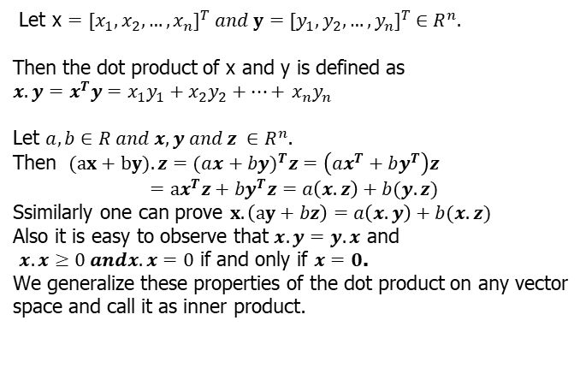
Dot product in R^{n}

Slide 11
Definitions: Bilinear Mapping, Symmetric Mapping and Positive Definite Mapping
A bilinear mapping Ω is a mapping with two arguments and is linear in both arguments: Let V be a vector space such that x , y , z ∈ V , and let λ, ψ ∈ R. Then we have
Ω(λx + ψy , z) = λΩ(x , z) + ψΩ(y , z), and
Ω(x , λy + ψz) = λΩ(x , y) + ψΩ(x , z).
Let V be a vector space and Ω : V × V → R be a bilinear mapping that takes two vectors as arguments and returns a real number. Then Ω is called symmetric if
Ω(x , y) = Ω(y , x). Also Ω is called positive-definite if
∀x ∈ V \ {0}, Ω(x , x) > 0 and Ω(0, 0) = 0.

Slide 12
Inner products
A positive-definite, symmetric bilinear mapping
Ω : V × V → R is called an inner product. To denote an inner product on V we generally write ⟨x , y⟩.
The pair (V , ⟨., .⟩) is called an inner product space.
Next we introduce the concept of symmetric, positive-definite matrices and show we can express an inner product using such matrices.
We recall that in a vector space V any vector x can be written as linear combination of the basis vectors. We use this to express an inner product in terms of a matrix.

Slide 13
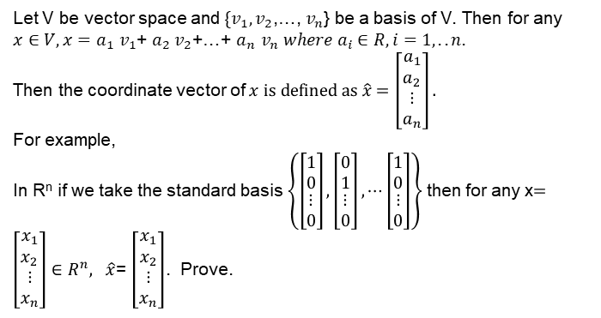
Notation for coordinates

Slide 14
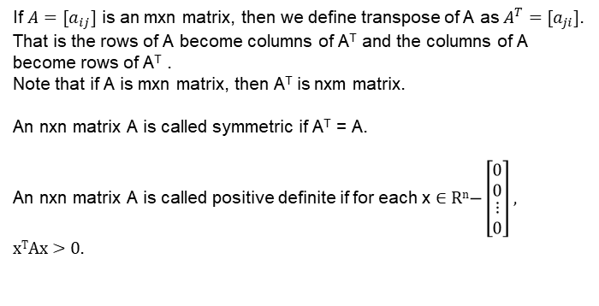
Symmetric Matrices and Positive Definite Matrices

Slide 15
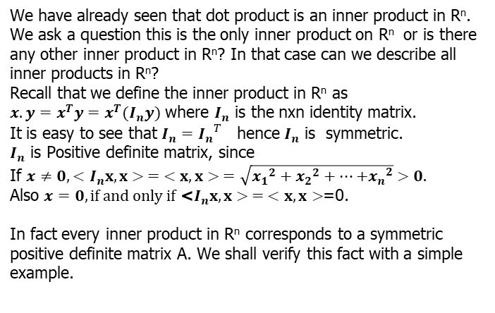
Relooking at Dot Product in R^{n}

Slide 16
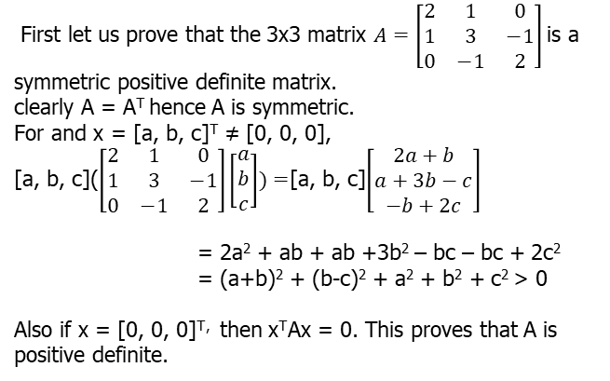
Example

Slide 17
Example(Ctd)
Now the inner product in R^{n} using this matrix A can be defined as <x, y> = X^{T}(Ay).
Proof:
< > is symmetric since <x, y> = X^{T}(Ay) = [X^{T}(Ay)]^{T} (Since <x, y> is a real number) = (Ay)^{T} X = (y^{T}A^{T})x = (y^{T}A)x = y^{T}(Ax) = <y, x> [The last two steps follow since A is symmetric and matrix multiplication is associative.]
<(ax+by) , z> = (ax +by)^{T} Az = (ax^{T}+ by^{T})Az
= a(x^{T}Az) + b(y^{T}Az)
= a<x, z> + b<y, z>
Similarly one can prove
<x, ay + bz> = a<x, y> + b<y, z>

Slide 18
Now <x, x> = x^{T}Ax > 0 if x ≠ 0. Since A is positive definite.
Also <x, x> = 0 if and only if x = 0.
Converse of this result is also true, namely if < > is an inner product on R^{n} then there exists a nxn symmetric positive definite matrix A such that <x, y> = x^{T}Ay.
This theorem can be generalized for any general metric space V which we sate and prove in the following slides.

Slide 19
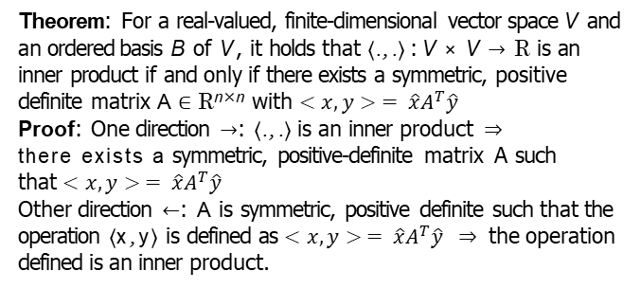
Symmetric, positive-definite matrices

Slide 20
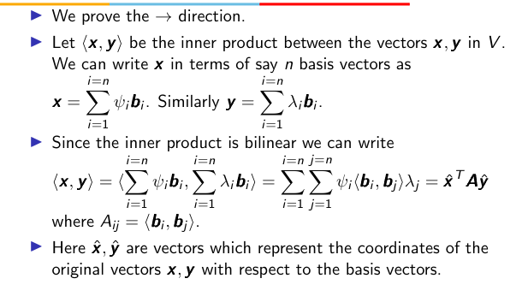
Proof (Ctd)

Slide 21
Proof (Ctd)
This means that the inner product is entirely determined through the matrix A. The symmetry of the inner product means that A_{ij} = ⟨b_{i}, b_{j} ⟩ = A_{ji} = ⟨b_{j}, b_{i} ⟩. Thus A is symmetric.
The positive-definiteness of the inner product means that
∀x ∈ V \{0}, x ^{T} Ax > 0.

Slide 22
Proof(Ctd)
Now let us consider an operation op such that x opy = xˆ^{T} Ayˆ where A is a symmetric, positive definite matrix.
We shall show that ”op” is an inner product by showing that it has all the properties of an inner product:
”op” has symmetry because x opy = xˆ^{T} Ayˆ and
y opx = yˆ^{T} Axˆ = yˆ^{T} (Axˆ). By a property of the dot product we can write yˆ^{T} (Axˆ) = (Axˆ)^{T} yˆ = xˆ^{T} A^{T} yˆ = xˆ^{T} Ayˆ where the last equality in the chain is possible since A is symmetric.

Slide 23
Proof(Ctd)
”op” also has bilinearity since we see that for
r ∈ R, (r x)opy = (r xˆ)^{T} Ayˆ = r xˆ^{T} Ayˆ = r (x opy).
Similarly we can prove r ∈ R, xop(ry)
(x + y)opz = (xˆ + yˆ)^{T} Azˆ = xˆ^{T} Azˆ + yˆ^{T} Azˆ = x opz + y opz.
Finally if x is a non-zero vector then xˆ is also a non-zero vector, x opx = xˆ^{T} Axˆ > 0 since we are given that A is positive-definite.

Slide 24
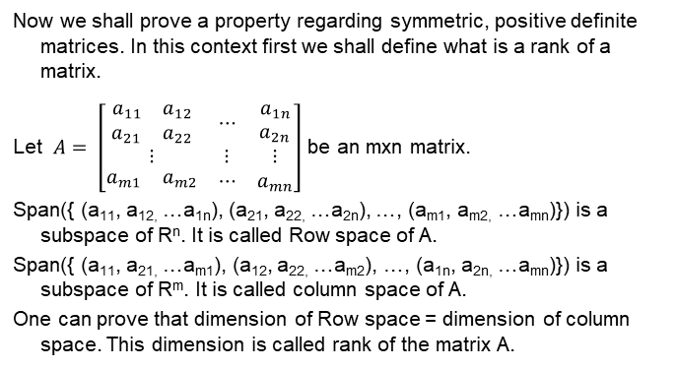
Rank of a Matrix

Slide 25
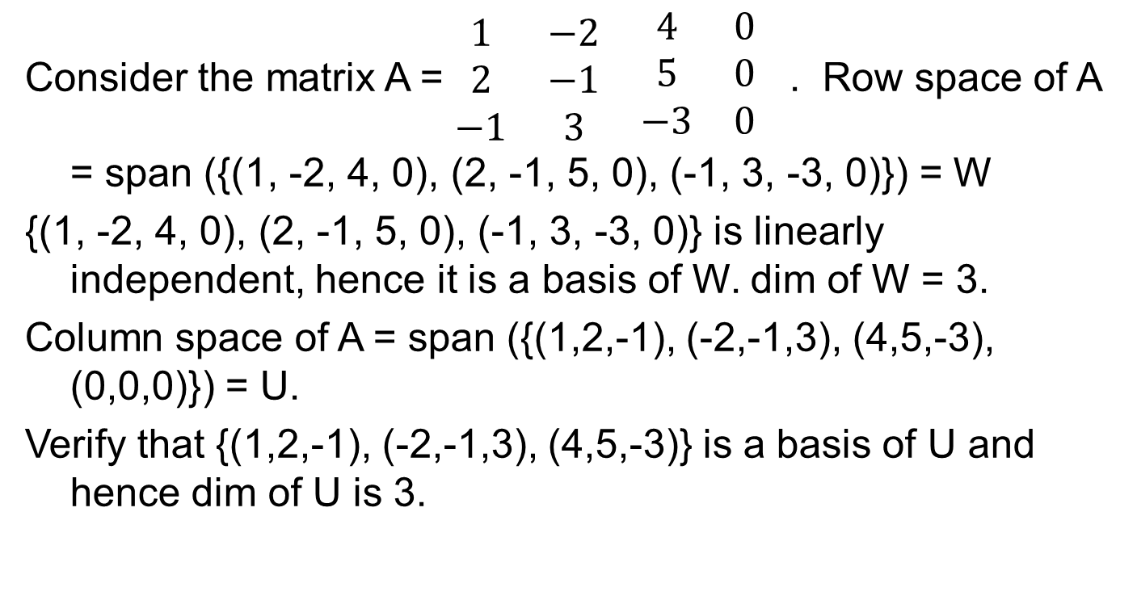
Example

Slide 26
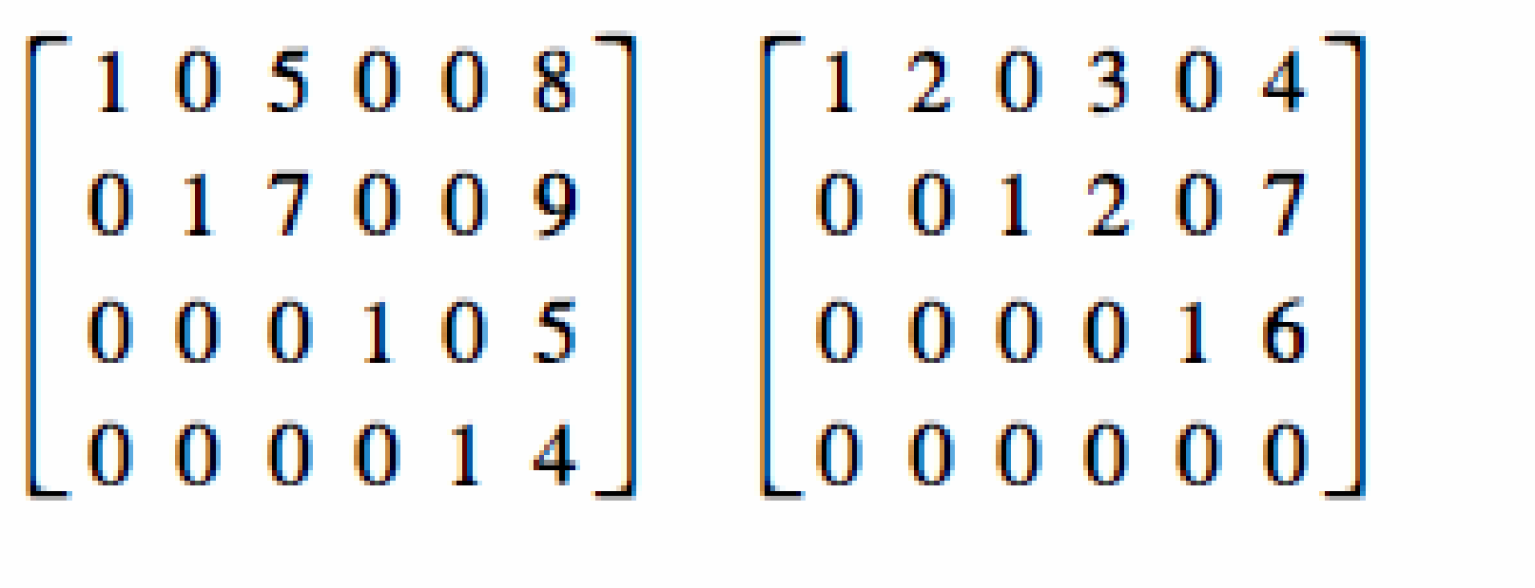
Method to find the rank of a matrix.
Theorem : The nonzero row vectors of a matrix A that is in echelon form is a basis for the row space of A. The rank of A is the number of nonzero row vectors.
These matrices are in echelon form.
Hance rank of the first matrix is 4 and the second matrix is 3.
Theorem: An nxn matrix A has rank n if and only if the homogenous equation AX = 0 has only the trivial solution(in other words the null space of A only 0 vector).

Slide 27
Properties of Symmetric , Positive Definite Matrices
Can a symmetric, positive-definite nxn matrix have rank less than n? We have x ^{T} Ax > 0 for all non-zero x. Thus the homogenous equation Ax = 0 has only a trivial solution. This means in the reduce row echelon form A, each column must have a pivot element. This means there is no zero row in the reduce row echelon form A Hence A must have rank n.
What can be said about the diagonal elements of a
positive-definite matrix? From (e_{i} )^{T} Ae_{i} > 0 where e_{i} is the i th canonical basis vector, we see that A_{ii} > 0. Thus the diagonal entries are all strictly positive.

Slide 28
Norms
A norm on a vector space is a function . : V → R, x → x which assigns to each vector x a length x such that for all λ ∈ R and x , y ∈ V the following properties hold:
Absolutely homogeneous: λx = |λ| x
Triangle inequality: x + y ≤ x + y
Positive definite: x ≥ 0 and x = 0 ⇔ x = 0
i =n
Manhattan norm : x = |x |
Σ
i
i =1
i =n
Euclidean norm : x =
Σ
x ².
2
i
i =1

Slide 29
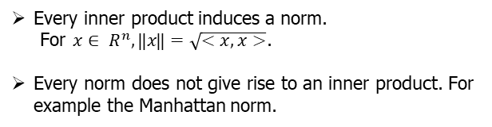
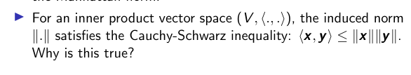
Norms and Inner Products

Slide 30
Proof of Cauchy-Schwarz inequality
Let u and v be two vectors and let us consider the length of the vector u − αv where α is a constant.
The length of the vector u − αv is greater than or equal to zero. The length of the vector u − αv is
T
u − αv ² = ⟨u − αv , u − αv⟩ = (u − αv) (u −αv).
we can expand the dot product
(u − αv)^{T} (u − αv) = u^{T} u − αu^{T} v − αv ^{T} u + α²v ^{T} v ≥ 0
►

Slide 31
Metric space
Consider an inner product space (V , ⟨., .⟩). Define d (x , y) the
distance between two vectors x and y to be
d (x , y) = x − y
If we use the dot product as the inner product, then the distance is called the Euclidean distance.
The mapping d : V × V → R is called a metric.
Problem: With respect the inner product < > defined using a matrix A in slide no 17, find the norm on R^{n} and also the distance between any two vectors in R^{n}

Slide 32
Properties of a metric space
A metric d has the following properties:
d is positive-definite which means d (x , y) ≥ 0 ∀x , y ∈ V .
d (x , y) = 0 =⇒ x = y.
d is symmetric which means d (x , y) = d (y , x) ∀x , y ∈ V .
d obeys the triangle inequality as follows:
d (x , z) ≤ d (x , y) + d (y , z) ∀x , y , z ∈ V
Inner products and metrics seem to be very similar in terms of their properties - however there is one important difference. When x and y are close to each other the inner product is large but the distance metric is small. On the other hand when x and y are far apart, then the inner product is small but the distance metric is large.

Slide 33
Angles and orthogonality
In addition to being able to capture the lengths of vectors and the distance between vectors, inner products can also capture the angle ω between two vectors and can thus capture the geometry of a vector space.
The key to using the inner product to characterize the angle between two vectors is the Cauchy-Schwarz inequality.
Assume that x and y are not the 0 vector. Then the Cauchy-Schwarz inequality tells us that
x ^{T} y
−1 ≤
≤ 1 (1)
x y

Slide 34
Angles and orthogonality
Since the Cauchy-Schwarz ratio lies between -1 and 1 we can set it equal to the cosine of a unique angle ω ∈ [0, π] such that
⟨x , y⟩
cos(ω) = (2)
x y
The angle ω is the angle between two vectors. What does it capture?
The notion of angle captures similarity of orientation between two vectors. When the dot product is close to zero, the vectors are more or less pointing in orthogonal directions and ω ≈ π/2.

Slide 35
Angles and orthogonality
Food for thought: Suppose we choose vectors x and y uniformly at random in high dimensions. What happens to the dot product between the vectors and hence the angle between them?
To choose a vector uniformly at random over a sphere let every component in the vector be an independent Gaussian random variable of mean 0 and unit variance.
Write a small program to see what happens ...

Slide 36
Angles and orthogonality
A key feature of the inner product is that we can use it to characterize vectors that are orthogonal.
Two vectors x and y are orthogonal if and only if the inner product between them is 0. For an orthogonal pair of vectors x, y we can write x ⊥ y.
By the above definition the 0-vector is orthogonal to all vectors.
Vectors which are orthogonal with respect to one inner product need not be orthogonal with respect to another inner product.

Slide 37
Example - angles and orthogonality
Consider the vectors x = [1, 1]^{T} and y = [−1, 1]^{T}
With respect to the inner product defined as a dot product we
see that ⟨x , y⟩ = x ^{T} y = 1 ∗ −1 + 1 ∗ 1 = 0.
2 0
►
With respect to the inner product x
T
y , the angle
0 1
between the two vectors x and y becomes
⟨x , y⟩
cos(ω) =
x y
= -1/3
Hence with respect to this inner product the vectors are no longer orthogonal.

Slide 38
Orthogonal matrix
A square matrix A ∈ R^{n×n} is an orthogonal matrix if and only if its columns are orthonormal:
A^{T} A = I = AA^{T}
_{A}T _{= A}−1
If the columns of a matrix are orthonormal, why are its rows orthonormal too? This follows from the fact that the
left-inverse of a square matrix is the same as the right-inverse. Let A be a square matrix with B and C the left and right inverses of A: BA = I = AC =⇒ B = C. Why is this true?

Slide 39
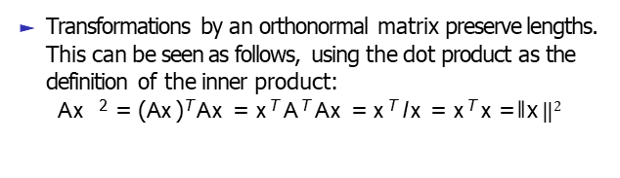
Orthogonal matrix
An example of an orthonormal matrix is the 2D-rotation
matrix which can be expressed as the angle of rotation.
cos θ −sinθ
where θ is
sinθ cosθ

Slide 40
Orthogonal matrix
Also the angle between two vectors x and y does not change after transformation by an orthogonal matrix. This can be seen as follows:
(Ax )^{T} Ay
Ax Ay
cos(ω) =
x ^{T} A^{T} Ay x y
x ^{T} y x y
=
=

Slide 41
Orthonormal basis
We already looked at the concept of a basis of a vector space, and found that for the vector space R^{n} we need n basis vectors.
Our basis vectors needed only to be linearly independent - we can ensure linear independence by ensuring that our basis vectors point in different directions, so that a linear combination of n − 1 basis vectors cannot cancel out the nth basis vector.
Now we will look at a special case of a basis where the vectors are all mutually orthogonal in the sense of the inner product, and each vector is of unit length. We call such a basis an orthonormal basis.

Slide 42
Orthonormal basis
Question: Can you immediately think of an orthonormal basis for R^{n}? Is an orthonormal basis for a vector space unique?
Formal definition of an orthonormal basis: Consider an
n-dimensional vector space V and n basis vectors
{b₁, b₂, . . . b_{n}}. If it is true that
∀i, j = 1, . . . n, i ̸= j ⟨b_{i}, b_{j} ⟩ = 0 and ⟨b_{i}, b_{i} ⟩ = 1, then the basis is called an orthonormal basis.
If the basis vectors are only mutually orthogonal but not of length unity, then we have an orthogonal basis.

Slide 43
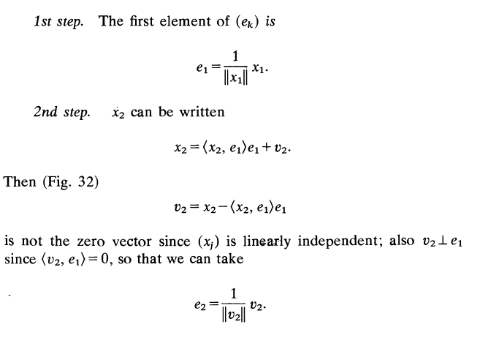
Gram-Schmidt Orthonormalization Method
Given a linarly independent set {x₁, x₂, …. x_{n}} we have to find an orthonormal set {e₁, e₂, … e_{n}} such that span {x₁, x₂, …. x_{n}} = span {e₁, e₂, … e_{n}} .

Slide 44
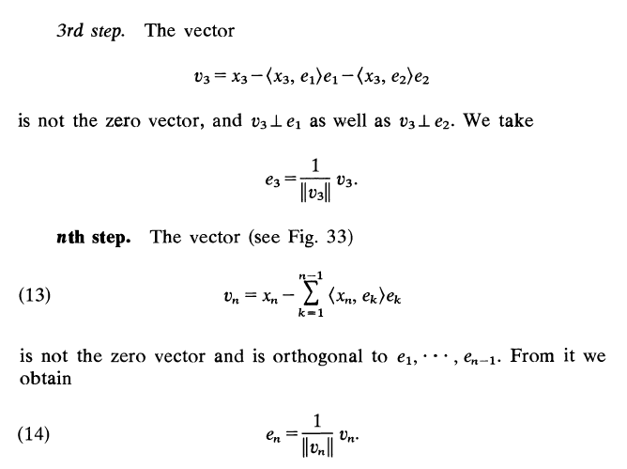
Gram-Schmidt Orthonormalization Method

Slide 45
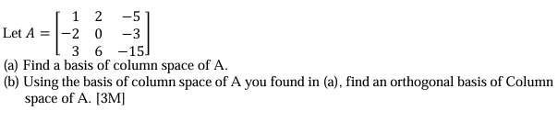
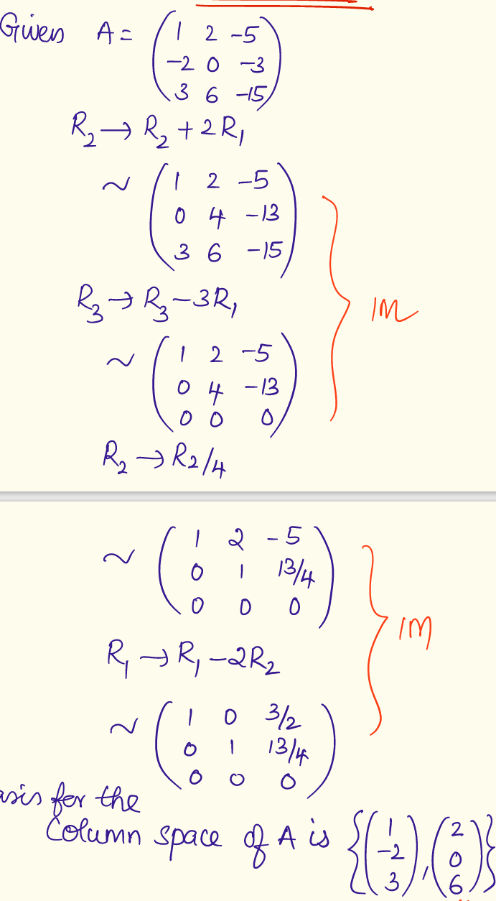
Example

Slide 47
